Slide 1
RESTAURANT TREND ANALYSIS AND RECOMMENDATION ENGINE BASED ON YELP DATA HISTORY

Slide 2
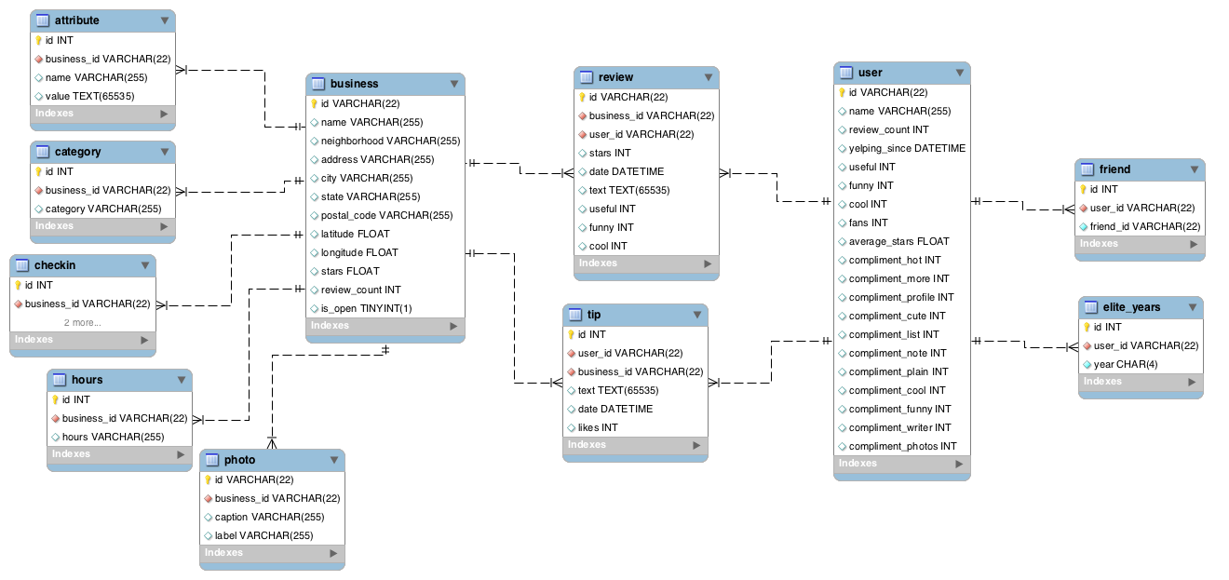
Previous Dataset Design:

Slide 3
Unnecessary tables, attributes.
Not normalized.
Dataset too large for handling.
Needs to be normalized.
To achieve this normalization, we initially ran through the setup of MySql software on our Windows 10 OS. We ran through python scripts for the execution of this normalization,

Slide 4
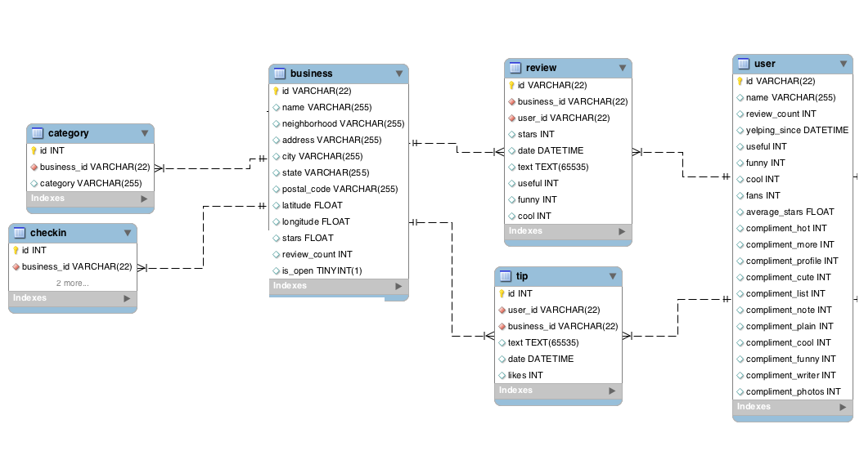
Normalized Design:

Slide 5
Data analysis of Restaurants
Using the database we uncover and understand various aspects of yelp Dataset.
We apply its usage for users and restaurant owners.

Slide 6
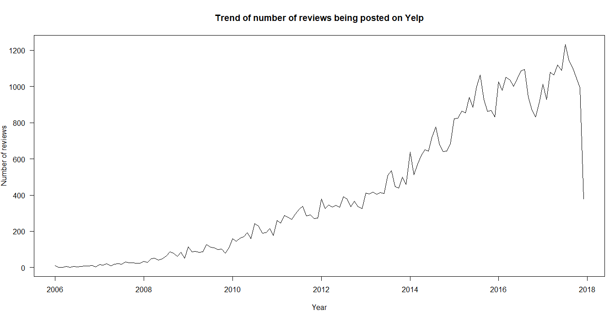
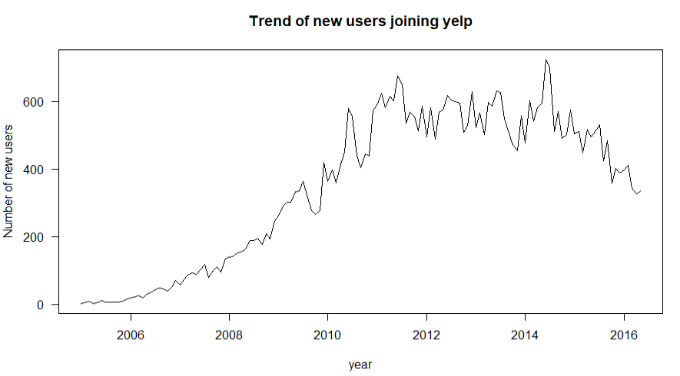
User Data:

Slide 7
We can reasonably conclude that there was a sudden spike in which when the number of users registered in the end of 2014
This followed by a spike in the increase in the number of reviews posted by users in 2015 beginning.

Slide 8
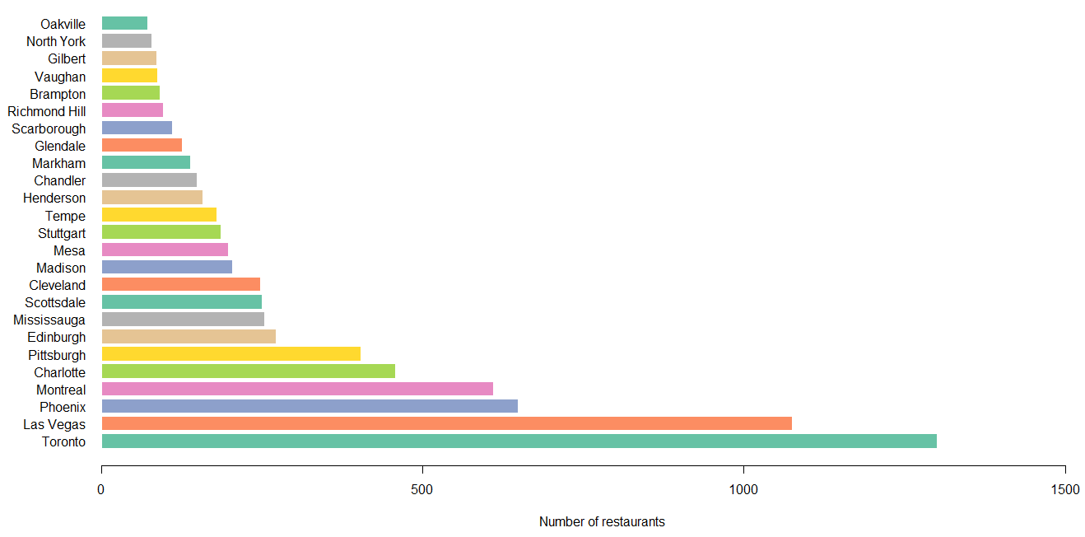
Cities with most number of restaurants

Slide 9
This data can probably help restaurant owners to determine where to set up their next restaurant.
Toronto seems to be highly populated restaurant according to the sampled dataset.

Slide 10
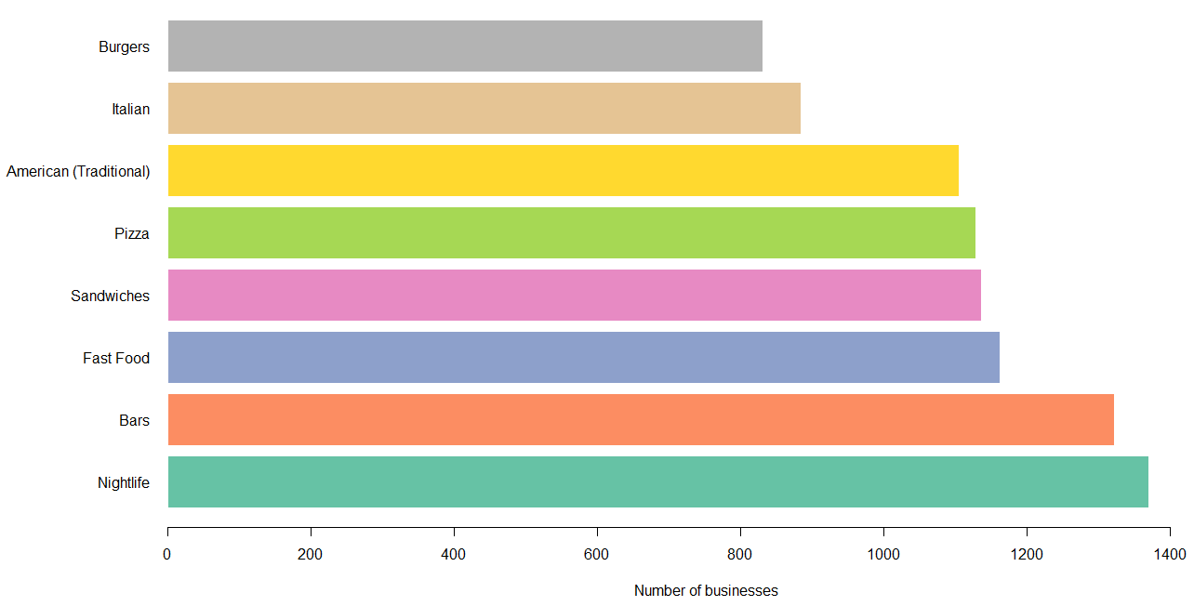
Popular Restaurant types:
This helps us conclude that the chance of higher profits is in the case of nightlife establishments.

Slide 11
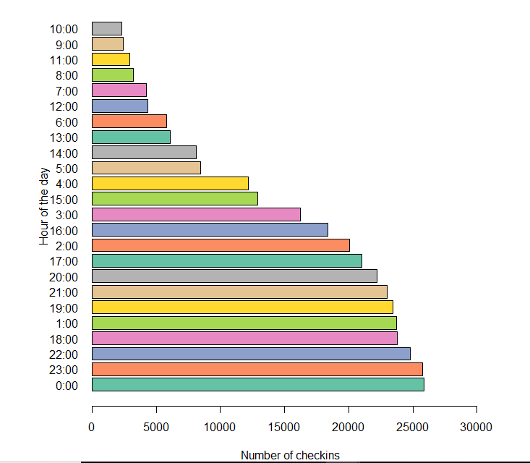
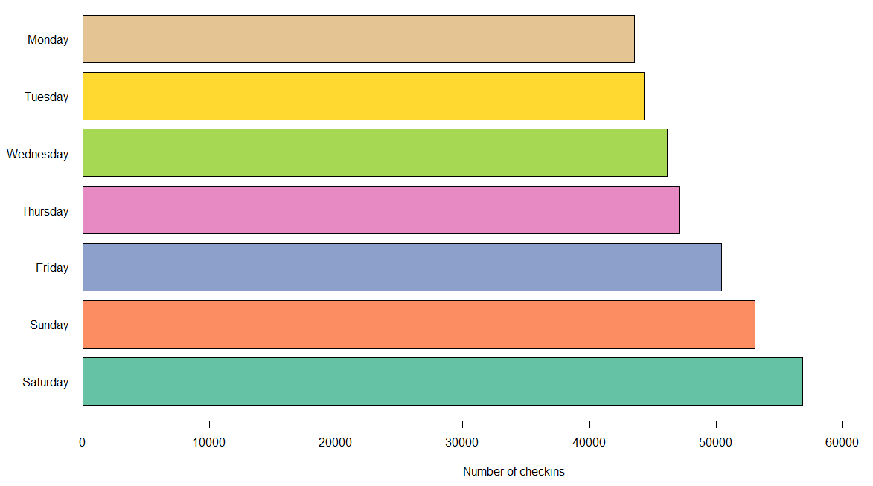
Busy Hours and Days of Restaurant
A user can avoid going to a restaurant using this data.
A restaurant can decide on “Happy hours” using this data.

Slide 12
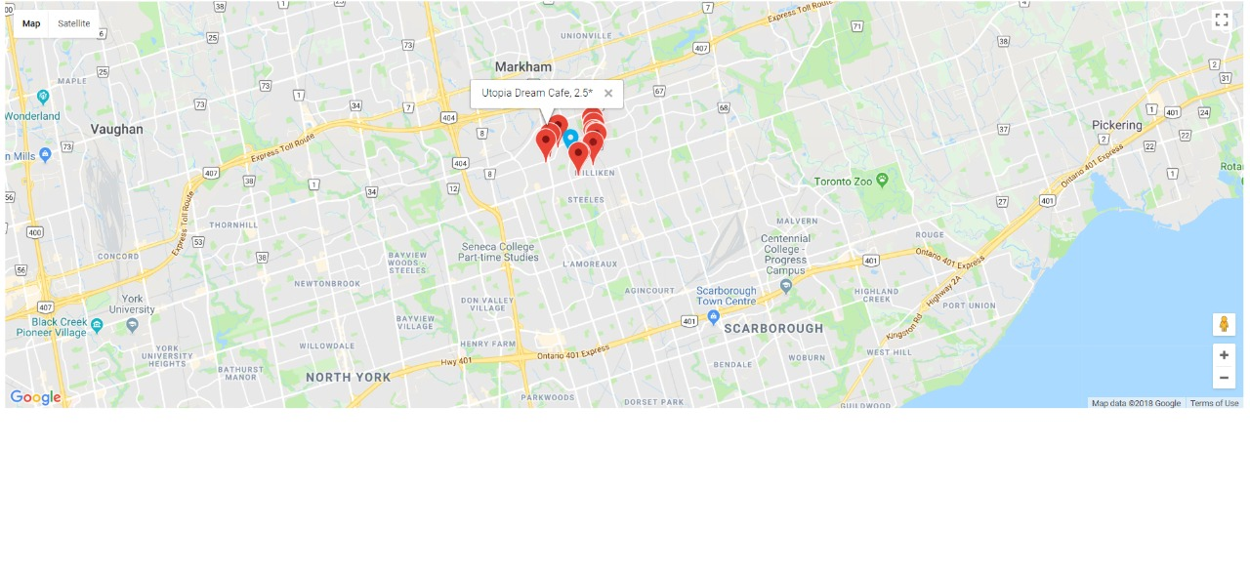
Map Plotting

Slide 13
Map plotting
This is the visual aspect of our project. The objective here is to give Latitude and Longitude, and based on these coordinates we find out the nearest restaurants, plot them using google maps api and also display the ratings of these restaurants so that the user can make an informed decision on the same.

Slide 14
Sentiment Analysis
Scan all data and preprocess it. This involved converting to lowercase, remove spaces,special characters,remove stop-words and remove stems.
Create list of all the words.
Find out frequency distribution and find thousand or desired value of words that will be most frequent and we will consider those relevant for our purpose.
Scan through all of the reviews again one by one and create ”one-hot” representation of each review.
Train Naive Bayes classifier with given ”one-hot” vector and label positive or negative that we have put manually.
Once trained on training data, we pass test data to naive bayes function. For test data, classifier predicts output and then checks if it was right or wrong.

Slide 15
Sentiment Analysis
In case of 5 star ratings, we can conclude that word choices like ”best” ”back” and ”service” are generally in the same realm of the user comment, it is likely to be an extremely positive review.
In case of 3 star rating, we can conclude that word choices like ”good” ”would” ”place” are in user comment, it can be an average review. Neither positive nor negative basically.
In case of 1 star rating, we can conclude that word choice like ”back” ”would” ”us” are in the comments of the user, it is likely to be a poor review.

Slide 16
What can we do to improve this project?
We can possibly use better servers and hardware as well as come up with better queries for the same.
We can make use of Boolean Multinomial Naive Bayes algorithm instead of the original Naive Bayes for sentiment analysis
We could simply use the queries generated by us to get a well furbished android/apple/Web UI so users can portably scan and use the yelp dataset.

Slide 17
CONCLUSION
We realize that by figuring out various attributes of the restaurant, we can help future potential business owners to set up or improve their businesses
Sentiment analysis is a very useful tool for the machine to give even more information about the vibe and service of a restaurant
We also provided an insight on how users can use the yelp dataset, to get them the best possible restaurant they want as per their location

